Slide 1
Maximum Residue Limits(MRL) of
Pesticide and Veterinary Drugs in Food
27th Nov. 2012
Food Standards Division
Korea Food & Drug Administration
* imh0119@korea.kr

Slide 2
Establishment of pesticide MRLs in Foods
MRLs have been established for specific crops or crop groups, and processed foods in Korea.
For example, a MRL for Tetraconazole was established for pome fruit (a crop group) and dried red pepper(a processed food).
(297) Tetraconazole, ADI : 0.0073 mg/kg b.w./day
Green & Red Pepper(Fresh) Red Pepper(Dried) Pepper Leave Perilla Leaves Strawberry | 1.0 3.0 1.0 15 1.0 | Mandarin Watermelon Cucumber Korean Melon Pome fruits | 2.0 0.2 1.0 1.0 1.0 | Tomato Sweet Pepper Squash Wild grape | 2.0 1.0 0.2 3.0
Pesticide residue DB : http://fse.foodnara.go.kr/residue

Slide 3
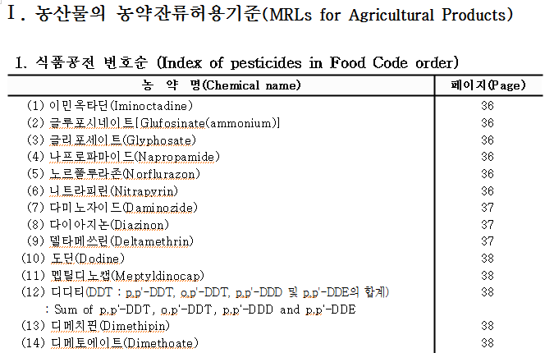
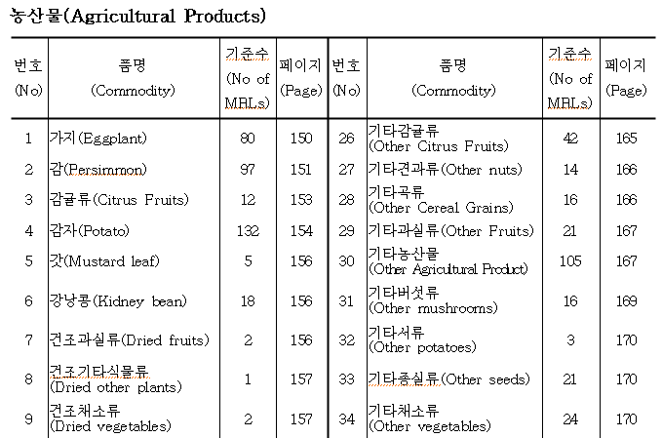
Pesticide MRLs in Korea
Pesticide MRLs have been established for 431 pesticides and 213 commodities in Korea.

Slide 4
Applicability of pesticide MRLs
If a MRL is not established,
Generally, the pesticide not resisted in Korea should not be detected in foods. Non-detection levels are determined from LOQ of the analytical method.
If a pesticide, where residue limit for an agricultural product was not established, is detected in the product, the following tentative limits shall be applied.
First, the Codex standard shall be applied.
Second, the lowest of the MRL in question specified for similar agricultural products shall be applied. (See the similar products in Classification of Food Raw Material in Korea Food Code.)
Third, lowest of the MRL, among MRLs of the pesticide detected, shall apply to the detected pesticide.

Slide 5
Example of Classification of Fruits for pesticide MRL
Type | Group | Commodity
Fruits | Pome fruits | Apple, Pear, Chinese quince, Persimmon, Pomegranate, etc.
 | Citrus fruits | Mandarin orange, Orange, Grapefruit, Lemon, Korean lemon, Lime, Kumguat, Trifoliate orange, Citron etc.
 | Stone fruits | Peach, Jujube, Apricot, Plum, Nectarine, Japanese apricot, Cherry, Korean-type cherry etc.
 | Berries and other small fruits | Grape, Strawberry, Fig, Mulberry, Bilberry or Cranberry, Currant, Berry, Boxthorn, Schizandra, Wild grape, Rubus coreanus (Including wild berry, Raspberry) etc.
 | Tropical fruits | Banana, Pineapple, Kiwifruit(Actinidia chinensis planch), Avocado, Papaya, Date palm, Mango, Guava, Coconut, Lychee, Passion fruit, Durian, etc.

Slide 6
Establishment of veterinary drug MRLs in Foods
MRLs have been established for livestock or fishery product foods in Korea.
For example, a MRL for Gentamicin was established for cattle, pig, chicken and fish
(1) Gentamicin
Cattle muscle Cattle liver Cattle fat Cattle kidney Milk Carp | 0.1 2.0 0.1 5.0 0.2 0.1 | Pig muscle Pig liver Pig fat Pig kidney Flatfish | 0.1 2.0 0.1 5.0 0.1 | Chicken muscle Chicken liver Chicken fat Chicken kidney Trout | 0.1 0.1 0.1 0.1 0.1
Veterinary drug residue DB : http://fse.foodnara.go.kr/residue/vd/index.jsp

Slide 7
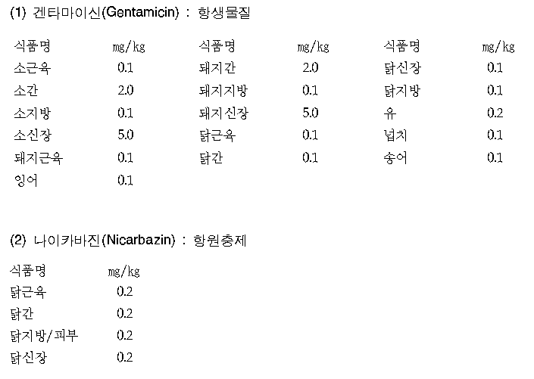
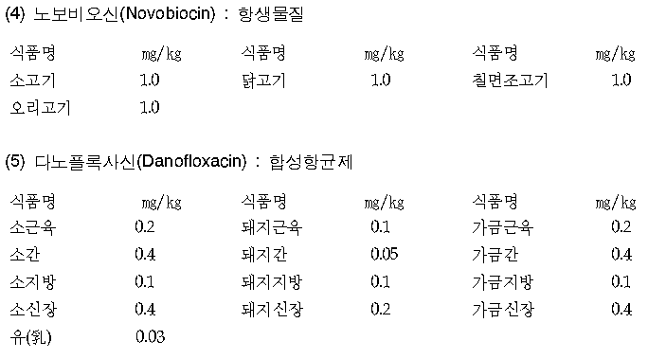
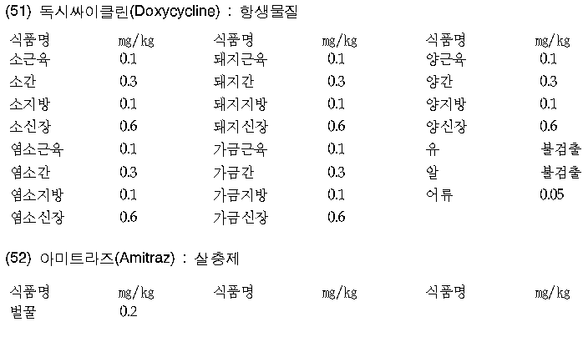
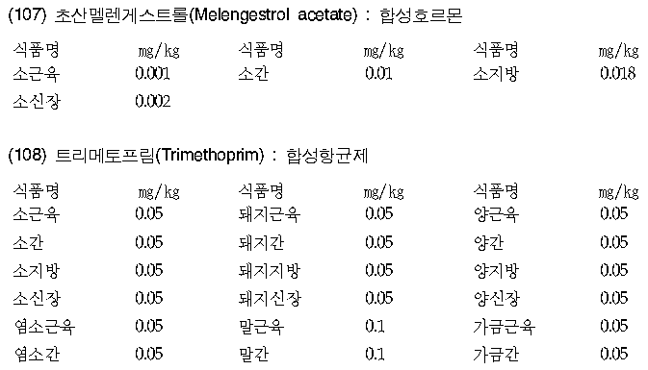
Veterinary drug in Korea
MRLs have been established for 156 veterinary drug and 60 foods in Korea.

Slide 8
Applicability of veterinary drug MRLs
If a MRL is not established,
Generally, the veterinary drug not registed in Korea should not be detected in foods. Non-detection levels are determined from LOQ of the analytical method.
If a veterinary drug, where residue limit for an livestock or fishery product was not established, is detected in the product, the following tentative limits shall be applied.
First, the Codex standard shall be applied.
Second, Application of the lowest residue limits in the area of the similar edible animals (only, horse, non-ruminant, shall follow the standard for ruminant)
Third, antibiotics and synthetic antibiotic substances in livestock and fishery products (including milk and eggs), and honey (including royal jelly and propolis) shall be limited to 0.03 mg/kg.

Slide 9
Example of Classification of livestock or fishery product for veterinary drug MRL
Group | livestock or fishery product
Ruminant | Cattle, sheep, goat. Deer etc
Nonruminant | Horse, pig, rabbit etc
Poultry | Chicken, duck, goose, turkey, quail, pheasant etc
Fishes | Snakehead, flatfish, sea bass, catfish, loach, yellow tail, eel, trout, gray mullet, carp, horse mackerel, gizzard shard, pseudorasbora palta etc
Crustacea | shrimp, crab, lobster, crayfish, small crab, krill etc

Slide 10
Positive List System (PLS)

Slide 11
Status of imported foods
Inspection of imported foods : 2007-2011 year
<Unit : cases, thousand tons, Million US dollars>
Classification | 2007 | 2008 | 2009 | 2010 | 2011
Case | 270,163 | 254,809 | 255,341 | 293,988 | 312,723
Weight | 11,799 | 11,731 | 11,301 | 12,905 | 13,471
Amount | 8,449 | 9,860 | 8,434 | 10,358 | 13,212
Reject (Rate) | 1,448 (0.54%) | 1,020 (0.40%) | 1,229 (0.48%) | 1,143 (0.39%) | 1,015 (0.32%)
Increasing Every years
Notes:
As you see, in Korea, Imported foods is increasing every year.

Slide 12
Promoting New regulations in Korea
Positive list system(PLS) will be adopted.
Background
Increasing food imports, accuracy of risk assessment has been challenged due to the fact that the imported foods are applied with MRLs in codex or tentative residue limits in similar agriculture products, livestock products and aquatic products.
So, it is necessary to evaluate the safety of the pesticides, which compounds are not registered in Korea, to protect human health.

Slide 13
Recently, the following works have being processed.
The MRLs before 2000 were adopted from MRLs of foreign countries, not based on scientific data. So, the MRLs should be re-evaluated for safety.
The pesticide and veterinary drug MRLs, which are not registered in Korea, are planned to be deleted from Korea Food Code.
See Withdrawn MRLs List (next presentation)
Exemption list will be considered and developed.
The compounds that should not be detected in foods will be listed as the compound can be harmful to human health.

Slide 14
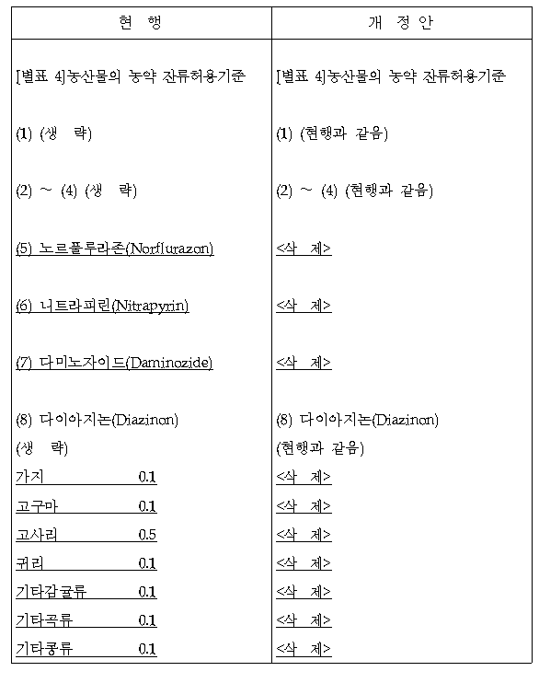
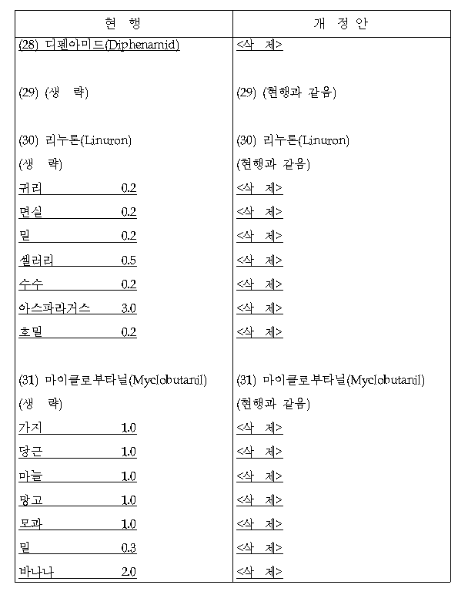
List of pesticide MRLs to be deleted
<Example>

Slide 15
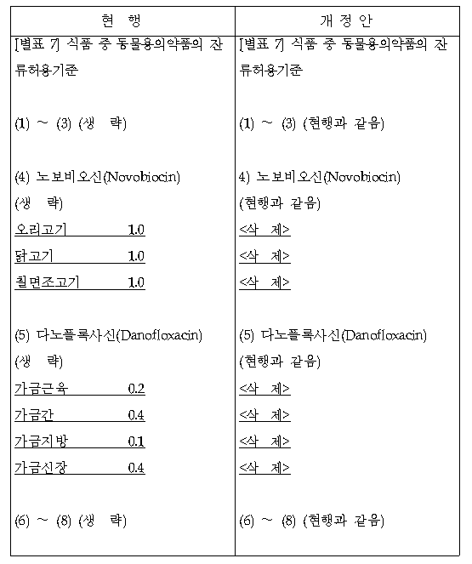
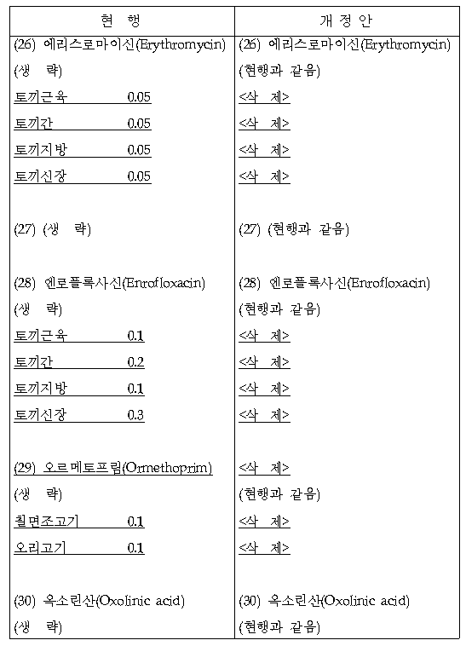
List of veterinary drug MRLs to be deleted
<Example>

Slide 16
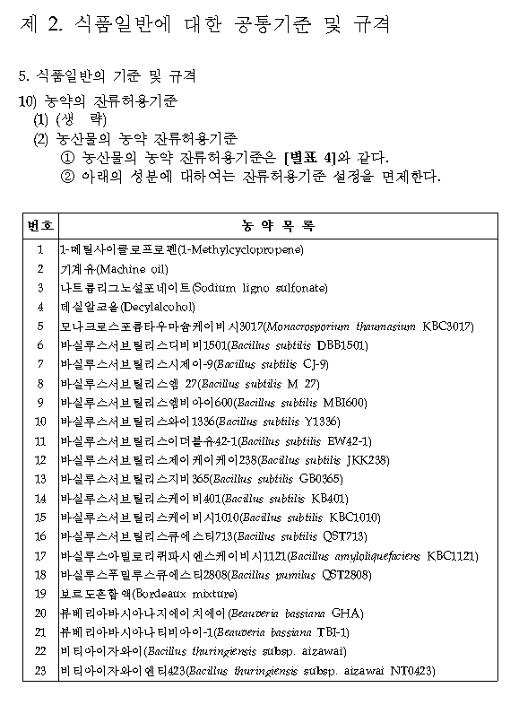
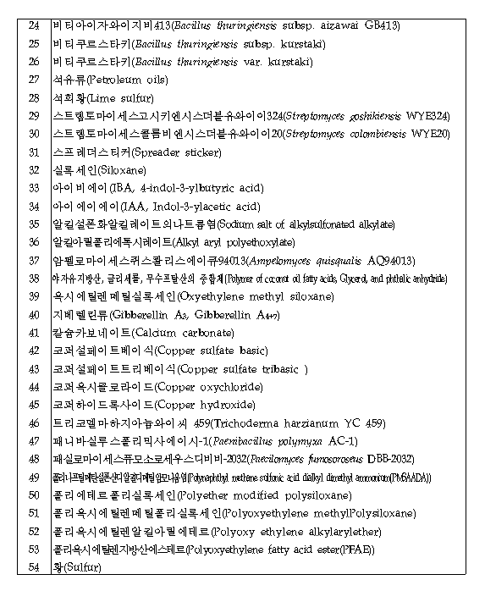
Exemption list
<Pesticide>

Slide 17
<Veterinary drug (example)>
No. | No MRL required
1 | Progesterone
2 | Estradiol-17beta
3 | Acetymethionine
4 | Acetylsalicylic acid
5 | Alanine
6 | Aluminium hydroxide acetate
7 | Calcium phosphate
8 | Vaitamin A
9 | Vaitamin B1
10 | ……

Slide 18
The compounds that should not be detected
in foods
Veterinary drug list that shall be not detected (example)
No. | Forbidden Veterinary drugs in foods
1 | Nitrofurans and its derivatives (Furazolidone, Furaltadone, Nitrofurazone, Nitrofurantoine, Nitrovin etc)
2 | Chloramphenicol
3 | Malachite green and its derivatives
4 | Diethylstilbestrol, DES
5 | Dimetridazole
6 | Clenbuterol
7 | Vancomycin
8 | Chlorpromazine
9 | Thiouracil
10 | Colchicine
11 | Pyrimethamine
12 | Medroxyprogesterone acetate, MPA

Slide 19
If a country or producing company which object to re-evaluate a compound, they are able to request the import tolerance.
It is expected that more than of 150 import tolerances will be requested in 2012.
As re-evaluating the MRLs of pesticide, the MRLs will be revised and established reasonably and harmoniously with the Codex MRLs.
Group MRLs will be extended.
The methods using GC-MS/MS and LC-MS/MS will be established for detecting pesticide and veterinary drug residues

Slide 20
Comments on the PLS will be collected from consumers, producers and importers.
It is planed to make an administration notice after gathering the information for PLS, and collect the comments for 2 years.

Slide 21
Change of Pesticide regulation in Korea
Current
After PLS adopted
Pesticide for which MRLs are set
(registered compound)
→ Food code is applied
Pesticide for which no MRLs have
been set
(not registered compound)
- Codex MRLs and MRLs for similar agricultural /livestock/ aquatic products is applied →
It is permitted to distribute the food in which pesticide residue level not exceed the MRLs.
※ Actually, the compounds have not been inspected.
Pesticide for which MRLs are set
(registered compound)
→ Food code is applied
Pesticide for which no MRLs have
been set
(not registered compound)
- It is not permitted to distribute the food in which pesticide residue level exceed 0.01 ppm.
Compounds authorized by Korea
Food and Drug Administration(KFDA)
- Not harmful compound
→ “Exemption list”
- Harmful compound
→ “Non-detection list”

Slide 22
Recently, KFDA has provided the Guidelines on MRLs for Pesticides and Veterinary Drugs in Food
The purpose of guidelines is…
To clarify procedures of establishment of MRLs, and to improve scientific transparency and predictability in establishment of MRLs to related companies
※ The English version of guidelines is available at
http://www.kfda.go.kr/eng/index.do > KFDA NEWS > News & Notice
* Guidelines for establishment of pesticide and veterinary drug MRLs in food

Slide 23
Guidelines for Establishment of Pesticide and Veterinary Drug MRLs in Food

Slide 24
Guidelines for Establishment of Pesticide
and Veterinary Drug MRLs in Food
- Notice No. 2012-15 of the KFDA(April 23, 2012)
Purpose
To clarify procedures of establishment of MRLs, and
to improve scientific transparency and predictability
in establishment of MRLs to related companies.
Attachment to Foods Import Report

Slide 25
Details
Scope of for the establishment of MRLs of Pesticides and Veterinary Drugs
Procedures and Methods for the Establishment of MRLs
Expert Review Panel and its Operation
Scope of Materials Submitted for the Establishment of MRLs
such as stipulations in toxicity and residue data for the establishment of MRLs
Methods for the Establishment of MRLs at Each Step
Various forms for the Establishment of MRLs
Attachment to Foods Import Report

Slide 26
Contents
Article 1 Purpose
Article 2 Definition
Article 3 Scope of Application
Article 4 Applications to Establish, Amend or Exemption of MRLs
Attachment to Foods Import Report
Article 5 Review to Establish, Amend or Exemption of MRLs
Article 6 Expert Review Panel and its Operation
Article 7 Matters for Consideration in Submitting document
Article 8 Supplementary Data, etc.
Article 9 Announcement and Notification
Article 10 Scope of Documents Submitted for the Establishment
of MRLs of Pesticides
Article 11 Scope of Materials Submitted for the Establishment
of MRLs of Veterinary Drugs

Slide 27
Scope of Application
Domestically used or registered pesticides;
Pesticides applied for use or registration domestically;
Pesticides that have MRLs and is used in overseas, albeit not used or registered domestically
Domestically used or registered veterinary drugs;
Veterinary drugs applied for use or registration domestically;
Veterinary drugs that have MRLs and is in use in overseas, albeit not used or registered domestically;
Pesticides or veterinary drugs that were used in the past, or have remained in the environment for too long and require a MRL.

Slide 28
Application for MRLs
Expected to register pesticide and veterinary drug in Korea
Pesticide : submit to Rural Development Administration(RDA)
Veterinary drug : submit to Animal, Plant and Fisheries
Quarantine and Inspection Agency(QIA)
Import tolerance for pesticide and veterinary drug
Those that wish to establish, change or exempt the MRLs must submit the application in the attachment 1 or 2 of this document, with relevant materials and summary reports attached, to the commissioner of the KFDA

Slide 29
Requirements for establishment of MRLs
In case of setting the MRLs for a compound, the following data and supports are requested by KFDA.
Toxicity data (Pesticide, Veterinary drug)
- Acute Oral Toxicity Studies(Oral toxicity, Dermal toxicity, Inhalation toxicity, Eye irritation, Dermal irritation, Dermal sensitization, Neurotoxicity)
- Sub-Chronic Toxicity Studies (90 day oral toxicity, 21/28 day dermal toxicity, 90 day inhalation toxicity, 90 day neurotoxicity, 28 day delayed neurotoxicity)
- Chronic Toxicity Studies(Repeated dose chronic oral toxicity, Carcinogenicity)
- Genetic toxicity studies
- Development and reproductive toxicity studies

Slide 30
- Teratogenicity studies
- Metabolism and pharmacokinetics
- Other toxicity data deemed necessary by the Commissioner in determining the establishment of maximum residue limit.
Residue Data (Pesticide)
- Basic information(Physicochemical characteristics, Applicable diseases and insect pests)
- Supervised trials for crops results
· Field description, Pesticide spraying tools and methods, Sample collection methods, Sample analysis method and recovery test result, Residue trial data, Storage stability, Proposed MRL, Guidelines on safe use
- Livestock, poultry, egg and milk residue data (directly, carry-over through feed ingestion)
- Plant metabolism data
- Other residue data deemed necessary by the Commissioner in determining the establishment of MRL

Slide 31
Processing study(Pesticide)
Miscellaneous(Pesticide)
- Usage and registration status in other countries
- MRL establishment status in Codex and other countries
- Impurity information regarding the product
※ Of materials to be submitted under paragraphs 1 and/or 2, should there be items that are meaningless to conduct tests on, and can be explained as such, theoretically and/or technically, then some of the materials can be omitted.

Slide 32
Residue data (Veterinary drug)
Physicochemical characteristics
Pharmacodynamics
Animals used in the tests (species, gender, age, weight, etc.)
Test conditions (breeding management, diet, drug administration method, and etc.)
Milk production and spawning ratio (when applicable)
Sampling method
Sample analysis method and recovery test result
Residue trial data
Storage stability
Proposed MRL
Withdrawal period

Slide 33
- Animal metabolism data
- Other residue data deemed necessary by the Commissioner in determining the establishment of MRL
※ Of materials to be submitted under paragraphs 1 and/or 2, should there be items that are meaningless to conduct tests on, and can be explained as such, theoretically and/or technically, then some of the materials can be omitted.

Slide 34
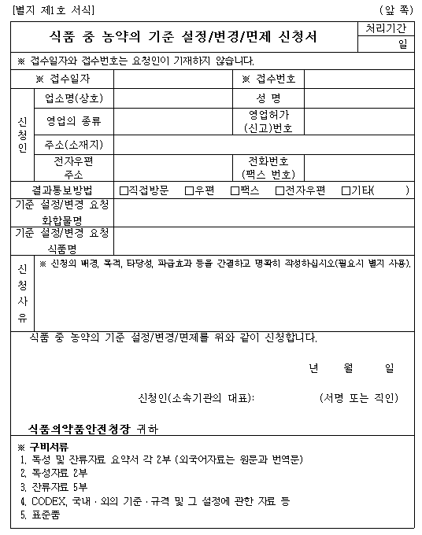
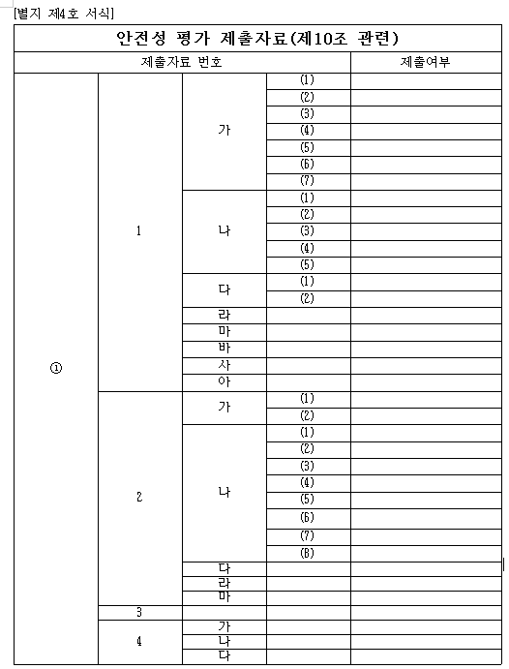
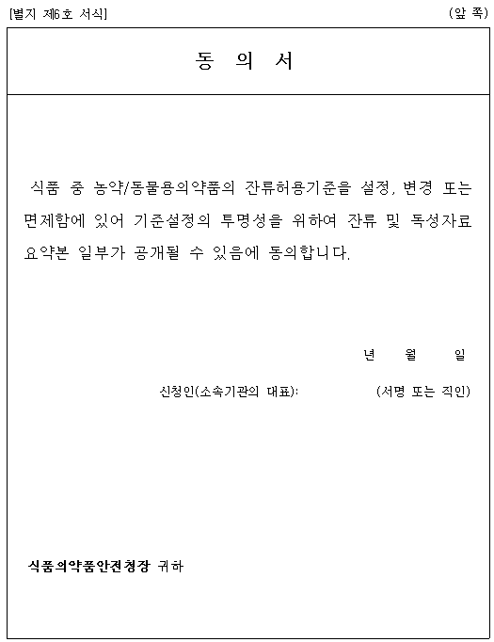
Application Form in Korea Food Code

Slide 35
Import tolerance

Slide 36
Status of the import tolerance apply
Year | Compound | Company | Food
2011 | Azoxystrobin | Syngenta | Orange, lemon, grapefruit
2011 | Fludioxonil | Syngenta | Orange, lemon, grapefruit
2011 | Fenpropathrin | Smitomo | Cherry
2011 | Oxyfluorfen | Dow agro | Apple and 17 others
2011 | Saflufenacil | BASF | Orange and 28 others
2011 | Imazlil | Janssen | Orange and 4 others
2011 | Pyrimethanil | Janssen | Orange and 7 others
2011 | Myclobutanil | Dow agro | Apricot, cherry, peach
2012 | 2,4-D | CCQC | Orange, lemon, grapefruit
2012 | Ametoctradin | BASF | Cabbage and 16 others

Slide 37
Year | Compound | Company | Food
2012 | Fluxapyroxad | BASF | Apple and 22 others
2012 | Sulfuryl fluoride | Dow agro | Almond and 4 others
2012 | Azoxystrobin | Syngenta | Rice and 12 others
2012 | Methoxyfenozide | Dow agro | Almond and 35 others
2012 | Chlorantraniliprole | Dupont | Potato and 32 others
2012 | Boscalid | BASF | Potato
2012 | Pyraclostrobin | BASF | Cherry
2012 | Saflufenacil | BASF | Pea and 6 others
2012 | Dicamba | BASF | Soybean and 8 others
2012 | Tilipirosin | Intervet | Cattle, pig
2012 | Zilpaterol-HCl | Intervet | Cattle

Slide 38
Import Tolerance
Total weight (ton)
Status of imported agricultural commodities in 2011

Slide 39
FAQ: Import Tolerance
1) Do you have any form for the application?
A: In, Korea Food Code [Appendix 8] Guidelines for Establishment of Pesticide and Veterinary Drug MRLs in Food. The application should be filled in Korean.
2) To whom should the application filed?
A: The application should be submitted to our division (Food standard division), Korea Food & Drug Administration.
3) Anyone who has not legal entity in Korea, could apply the petition directly?
A: Anyone can apply the import tolerance directly, But should be available to contact with us (phone, e-mail, etc.).
4) English is acceptable?
A: Yes, English report is acceptable including the data. But, summary report should be written in Korean.

Slide 40
FAQ: Import Tolerance
5) The necessary information/data might be different between pesticides, which the Korean domestic registration is existed (already reviewed the toxicity data) or not.
May we understand that only the residue data would be sufficient for the application of the import MRLs?
A : When the pesticide already resisted for the other commodities, the residue data is sufficient for the application of the import MRLs
6) How long it will take for the review and establishment of import MRLs after the application?
A : It will be take 365 days for a new compound, and 210 days for the additional establishment or alleviation of MRL.

Slide 41
Thank you

